Slide 1
Code Refactor
--By Shengli

Slide 2
Agenda
Why
When
How
Rules

Slide 3
Why we need Code Refactor?
Improve the design
Easy to understand the code
Easy to find out the bug
Speed up the coding

Slide 4
When to do Code Refactor?
When add new feature
When bug fixing
When code review

Slide 5
Bad Smell
Duplicated
Long Method
Large Class
Long Parameter List
Divergent Change
Shotgun Surgery
Feature Envy
Data Clumps
Primitive Obsession
Switch Statement
Parallel Inheritance Hierarchies
Lazy Class
Speculative Generality
Temporary Field
Message Chains
Middle Man
Inappropriate Intimacy
Alternative Classes with Different Interface
Incomplete Library Class
Data Class
Refused Bequest
Comments

Slide 6
How to do Code Refactor
Duplicate Code(重复代码)
Extract method(提炼函数)
Same logic in two method of one class
Pull up method(函数上移)
将函数移至超类
From template method(塑造模板函数)
Substitute Algorithm(替换算法)
Extract Class(提炼类)

Slide 7
How to do Code Refactor
Long Method(过长函数)
Extract Method(提炼函数)
Replace Temp with Query(以查询取代临时变量)
Introduce Parameter Object(引入参数对象)
Preserve Whole Object(保持对象完整)
Replace Method with Method Object(以函数对象取代函数)
Decompose Conditional(分解条件表达式)

Slide 8
How to do Code Refactor
Large Class(过大的类)
Extract Class(提炼类)
Extract Subclass(提炼子类)
Duplicate Observed Data(复制“被监视的数据”)

Slide 9
How to do Code Refactor
Long Parameter List(过长的参数列)
Replace Parameter with Method(以函数取代参数)
Preserve Whole Object(保持对象完整)
Introduce Parameter Object(引入参数对象)

Slide 10
How to do Code Refactor
Divergent Change(发散式变化)
Extract Class(提炼类)
Divergent change occurs when one class is commonly changed in different ways for different reasons.

Slide 11
How to do Code Refactor
Shotgun Surgery(霰弹式修改)
Move Method(搬移函数)
Move Field(搬移字段)
Inline Class(将类内联化)
Divergent change is one class that suffers many kinds of changes
Shotgun surgery is one change that alters many classes

Slide 12
How to do Code Refactor
Feature Envy(依恋情结)
Move Method(搬移函数)
Extract Method(提炼函数)
a method that seems more interested in a class other than the one it actually is in.

Slide 13
How to do Code Refactor
Data Clumps(数据泥团)
Extract Class(提炼类)
Introduce Parameter Object(引入参数对象)
Preserve Whole Object(保持对象完整)
Bunches of data that hang around together really ought to be made into their own object.

Slide 14
How to do Code Refactor
Primitive Obsession(基本类型偏执)
Replace Data Value with Object(以对象取代数据值)
Replace Type Code with Class(以类取代类型码)
Replace Type Code with Subclasses(以子类取代类型码)

Slide 15
How to do Code Refactor

Slide 16
How to do Code Refactor

Slide 17
How to do Code Refactor

Slide 18
How to do Code Refactor

Slide 19
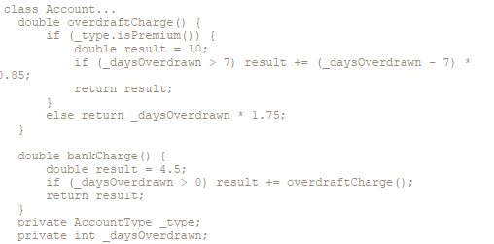
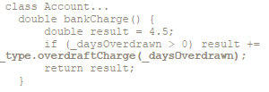
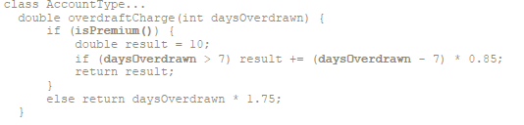
Move Method

Slide 20
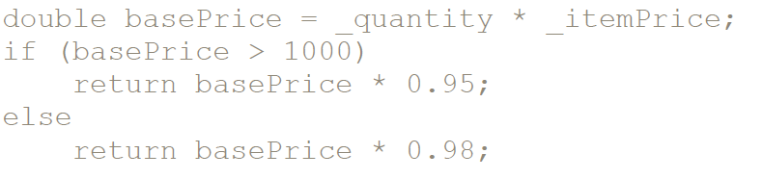
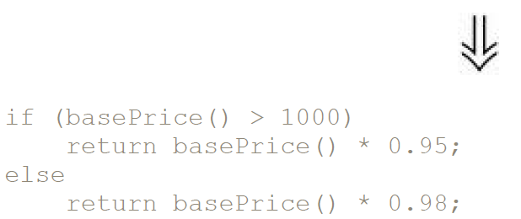
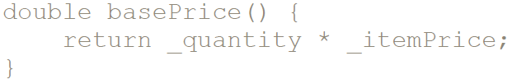
Replace Temp with Query
Tips:
Preparation for Extract Method
Declare the temp as final

Slide 21
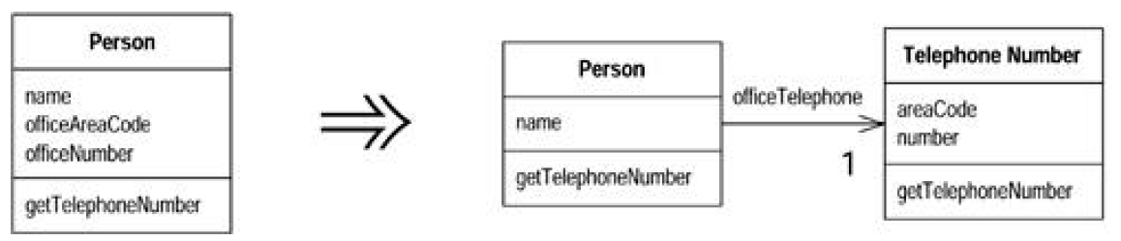
Extract Class
Tips:
One class doing work that should be done by two

Slide 22
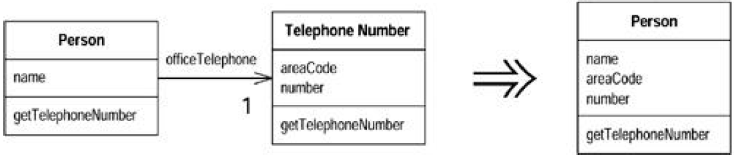
Inline Class
Tips:
A class isn't doing very much

Slide 23
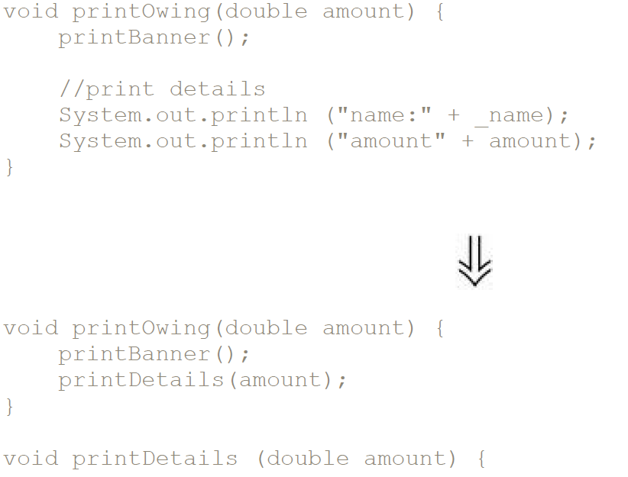
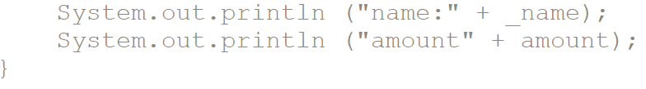
Extract Method
Tips:
Good Naming

Slide 24
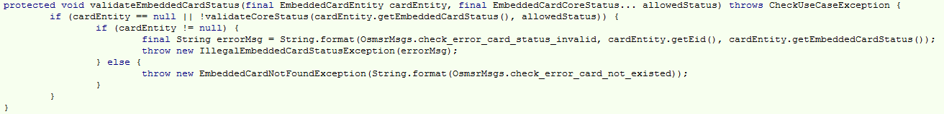
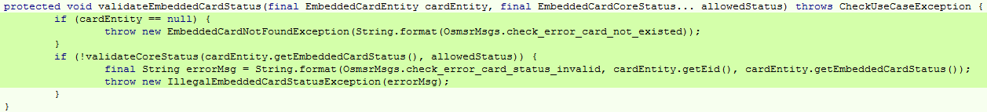
Substitute Algorithm

Slide 25
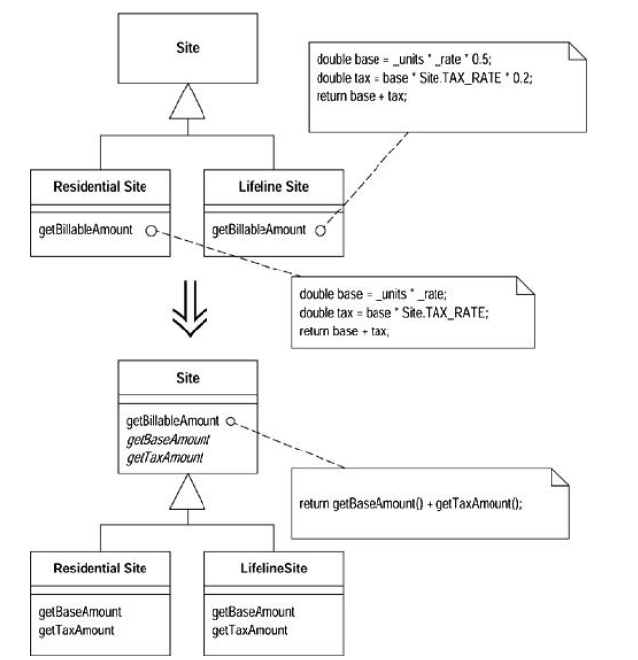
From template method

Slide 26
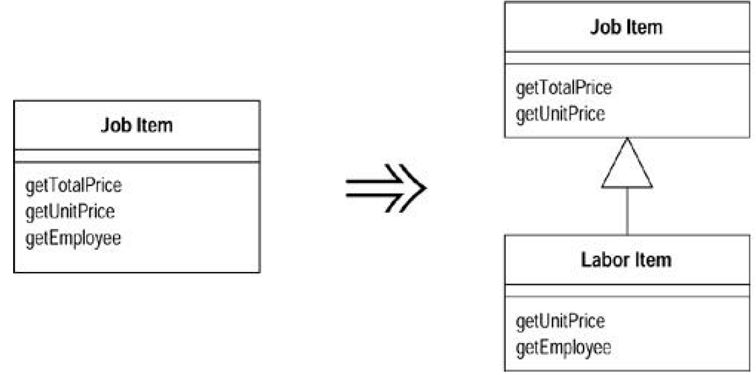
Extract Subclass
Tips:
behavior used for some instances of the class and not for others

Slide 27
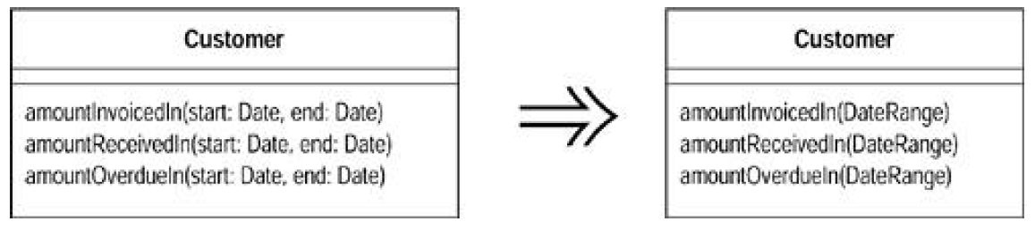
Introduce Parameter Object

Slide 28
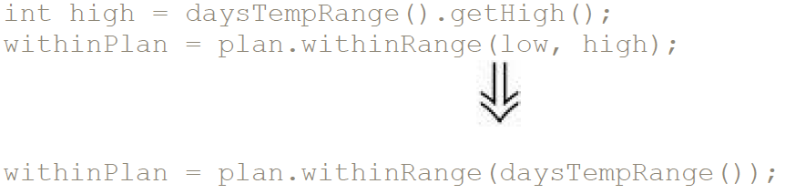
Preserve Whole Object

Slide 29
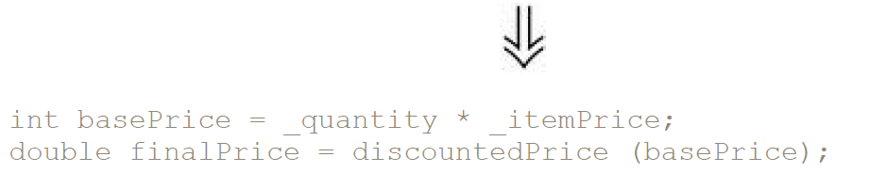
Replace Parameter with Method
Tips:
whether the receiving method can make the same calculation.

Slide 30
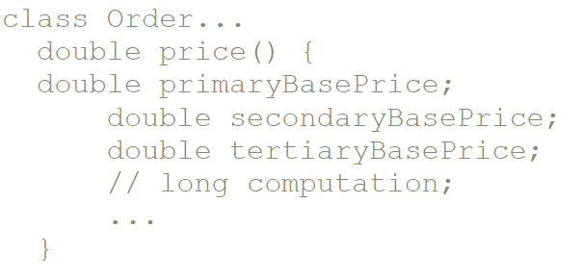
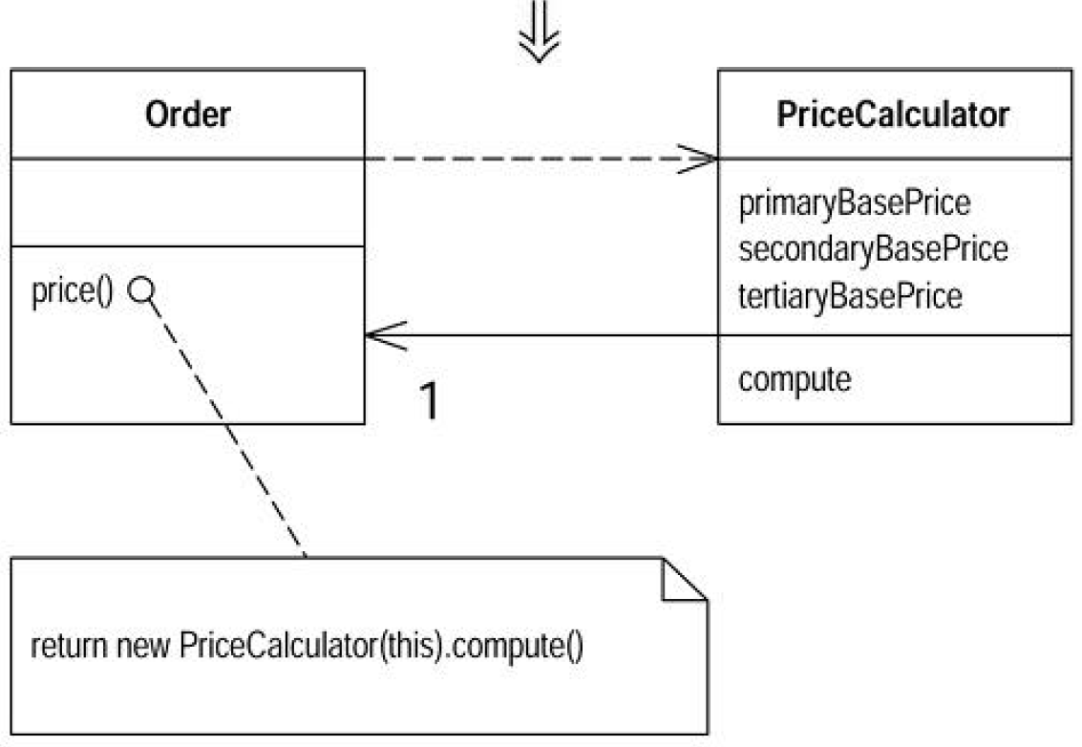
Replace Method with Method Object

Slide 31
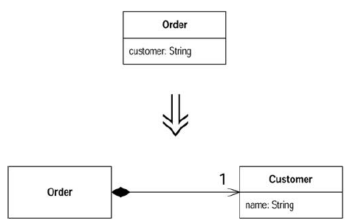
Replace Data Value with Object

Slide 32
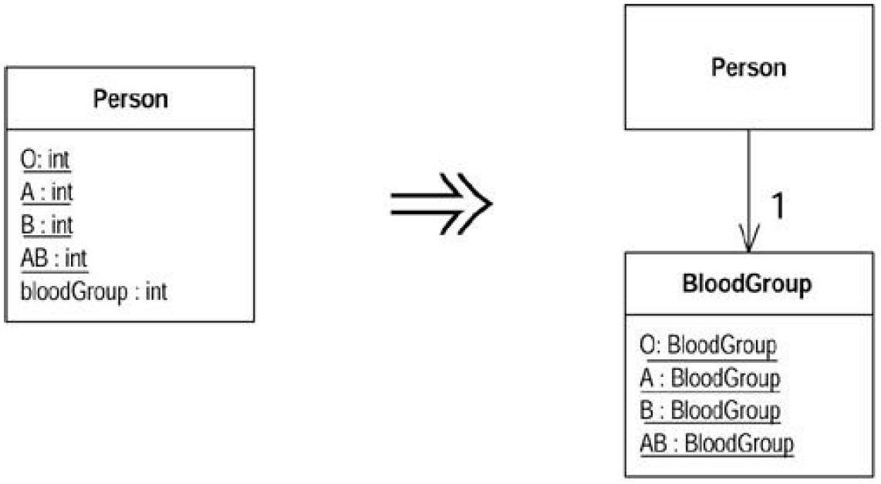
Replace Type Code with Class

Slide 33
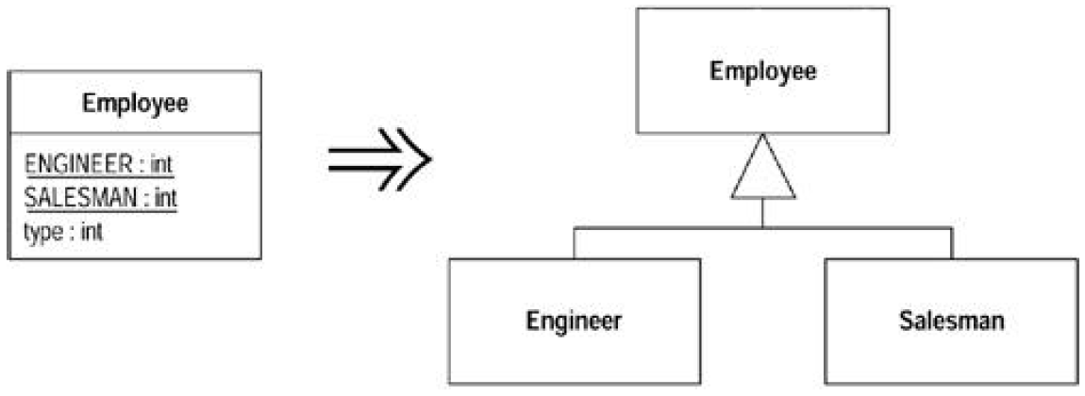
Replace Type Code with SubClass

Slide 34
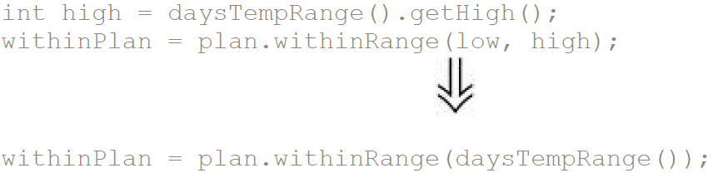
Preserve Whole Object

Slide 35
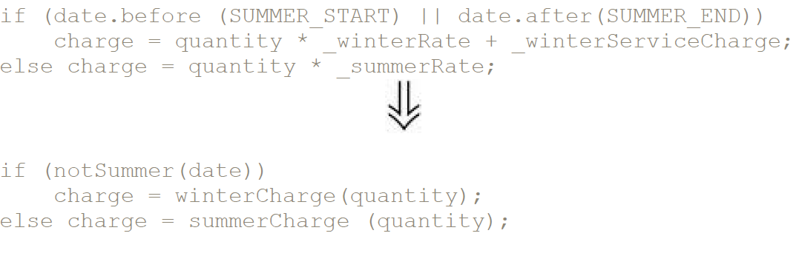
Decompose Conditional

Slide 36
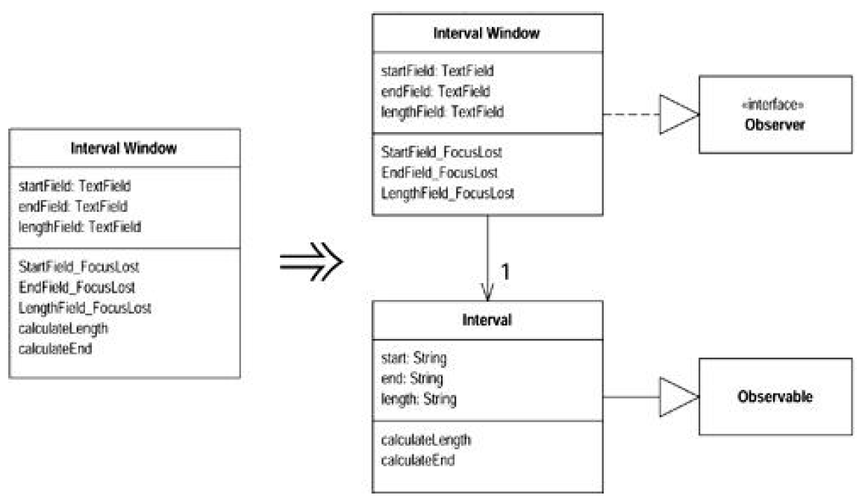
Duplicate Observed Data

Slide 37
OSMSR – Project dependency

Slide 38
OSMSR – Constants

Slide 39
OSMSR – Enable Profile

Slide 40
OSMSR – Enable Profile

Slide 41
OSMSR – State Manager

Slide 42
Business Manager

Slide 43
OSMSR – Check User Privilege

